Slide 1
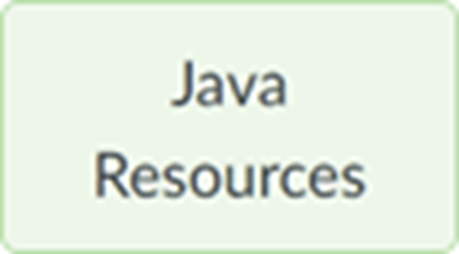
Section 05 (week of Oct 2): Advanced Java part 4
We'll start at 5:01 (Tuesday) and 7:16 (Wednesday) Eastern Time.
Pset 2 is due at start of the lecture 6 week at 9am. See the Notes.
Your questions
File Input And Output
More Class Stuff
Access Modifiers, Packages
final modifier
Zip file with this section’s slides and sample code is posted to course’s page

Slide 2
File Input And Output
So far our programs only read from and write to the user’s terminal.
Now we’ll begin to explore reading/writing text files via java.io package
import java.io.File; File f = new File( "foo.txt" );
Java API reference is your friend.
Command-line arguments
public static void main( String [] args )
args contains command line arguments
Filenames are frequently passed via command line arguments
Psets’ program classes shouldn’t use command line args unless the pset says to!
See FileClassDemo.java

Slide 3
More Class Stuff
Multiple classes in one file
Multiple classes in separate files
Automatic compilation
Public classes
See MultipleClasseInOneFile, MultipleClassesInSeparateFiles.java, PublicClasses.java

Slide 4
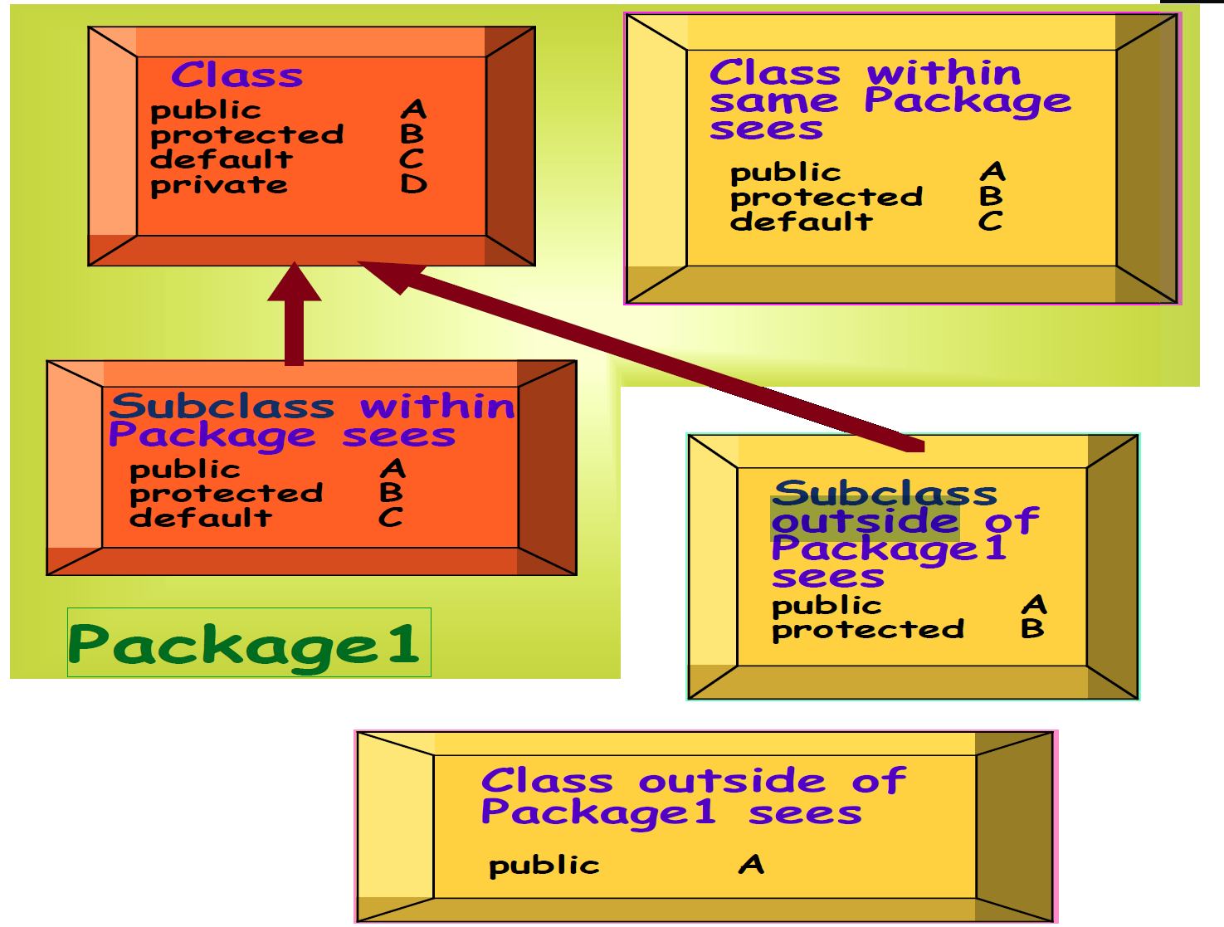
Access Modifiers

Slide 5
Access Modifiers
public
variable or method: can be accessed inside or outside the class in which it appears.
class: can be accessed inside or outside the package in which it appears.
protected
feature can be accessed inside the class in which it appears, inside other classes in the same package, or inside subclasses in any package.
default
feature can be accessed inside the class in which it appears, inside other classes in the same package, or inside subclasses in the same package.
private
feature can be accessed inside the class in which it appears.
See fooPackage\FooClass.java, barPackage\BarClass.java

Slide 6
Packages ¹
Packages are collections of importable classes
By default, all classes within a folder are in the same (anonymous) package
Classes in files containing a package foo statement are in the foo package
import java.util.Scanner or import java.util.*
A package’s classes’ folder’s path must match the package’s name
That folder’s parent needs to be in the CLASSPATH
javac –CP path Foo.java
cd <packagename parent>, then javac Foo.java
CLASSPATH environment variable
¹ The packages discussion is background information that WON’T be on the midterm or final.

Slide 7
final modifier
final class: cannot extend.
final method: cannot override.
final variable: cannot change value.
See FinalClassesAndMethods.java

